Slide 1
Chaos Game Representation for Genetic Sequences
Devisetty Mithil Sri Sai
K Vinayak Shiva Rupan S
Vasudevan K M

Slide 2
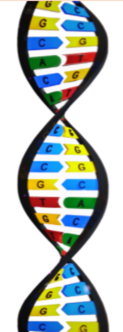
Table of Contents
01
02
03
04
Introduction
Working of the algorithm
Introduction to the topic
Working of chaos game representation algorithm
Walkthrough of the code
Observations and results
Exploring the code of the chaos game representation algorithm
Reporting the observations and limitations

Slide 3
INTRODUCTION
Chaos Game Representation(CGR) is a graphical representation of a sequence. It is a method of converting a long one-dimensional sequence (in our case a genetic sequence) into a graphical form.
It is a novel holistic approach that provides a visual image of a DNA sequence quite different from the traditional linear arrangement of nucleotides.
CGR can recognize patterns in the nucleotide sequences, obtained from databases of a class of genes using the techniques of fractal structures and by considering DNA sequences as strings composed of four units, A, T, C and G.

Slide 4
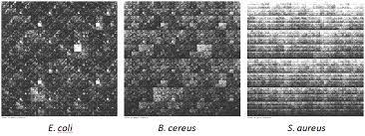
What is CGR used for?
CGR is an application of non-random input to an iterated function system.
The method was first proposed for the DNA sequence, now it is being used for any arbitrary symbols. Since the patterns are unique to genomes this can be used to identify genome fragments or to detect horizontal gene transfers.
In addition, quantitative analysis of CGR patterns can be used for sequence comparison both alignment-free and alignment-based sequence comparisons are possible with CGR.

Slide 5
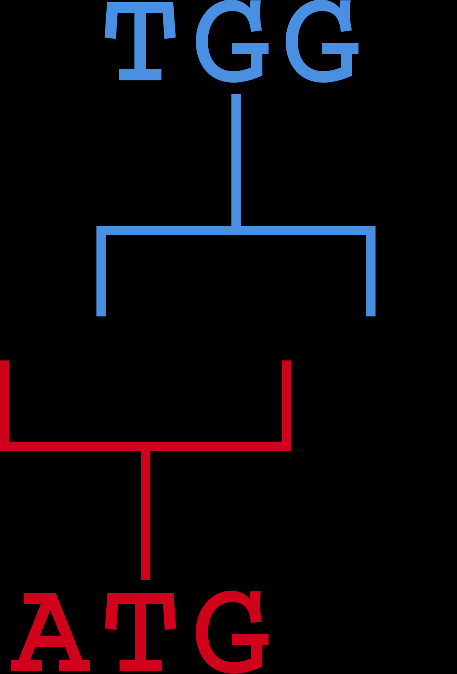
Where to start?
To start drawing our chaos game representation, we have to count our k-mers first. The term k-mer usually refers to a specific n-tuple or n-gram of nucleic acid or amino acid sequences that can be used to identify certain regions within bio-molecules like DNA (for gene prediction) or proteins.
Either k-mer strings as such can be used for finding regions of interest, or k-mer statistics giving discrete probability distributions of a number of possible k-mer combinations (or rather permutations with repetitions) are used. Specific short k-mers are called oligomers or “oligos” for short.

Slide 6
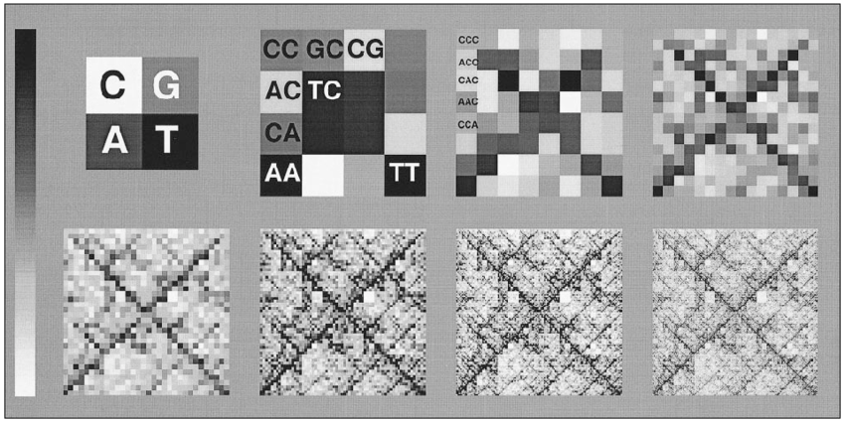
Chaos Game Representation
The Chaos Game Representation (CGR) is an iterative mapping technique that processes squence’s of units, such as nucleotides in a DNA sequence or amino acids in a protein, in order to find the coordinates for their position in a continuous space.
The distribution of the points in the CGR plane were shown to be a generalization of the Markov chain probability tables that accommodates non-integer orders.
Since, CGR is a generalized scale-independent Markov probability table for the sequence, oligomer tables can be deduced from CGR image.

Slide 7
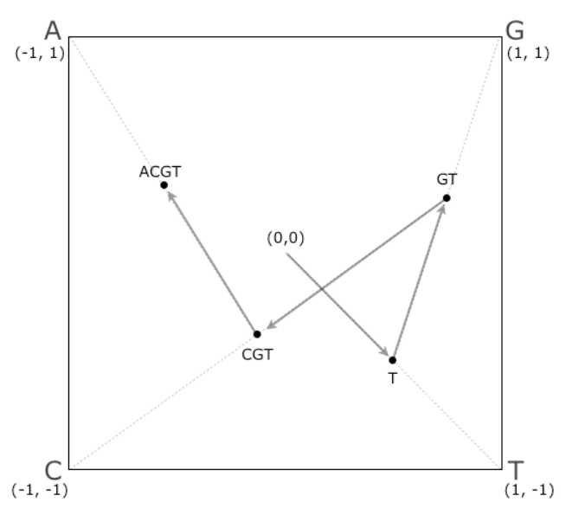
PROCEDURE
The pseudo code for the Chaos Game Representation :
Start from position (0,0), the origin of the two-dimensional coordinate.
Four different nucleotides are located:
-A: (-1, 1) upper left
-T: (1, -1) lower right
-G: (1, 1) upper right
-C: (-1, -1) lower left
For each nucleotide(in reverse order to match k-mer table), move and mark the new location which is halfway between the current location and the nucleotide.
Repeat this procedure for all the nucleotides.

Slide 8
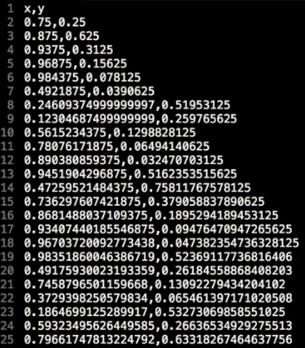
Constructing the CGR Image
A(-1,1)
C(1,1)
TGCA
TGC
(0,0)
T
TG
T(-1,-1)
G(1,-1)
Iterative system with n = 4, r = 1/2: For each nucleotide in the k-mer, traverse half the distance towards the corner corresponding to that nucleotide

Slide 9
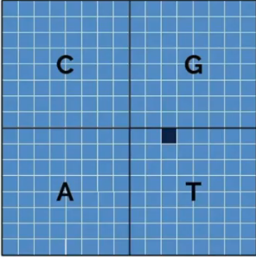
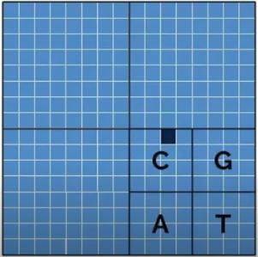
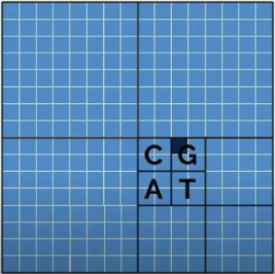
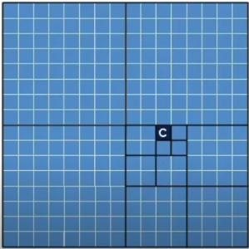
C
G
C
G
For each letter in an oligomer, a box is subdivided into four quadrants
So, each of the 4^{k} boxes correspond to a unique k-mer
Each box is colored gray with different intensities depending on the probability of occurrence of that k-mer
A
T
A
T
C
G
C
G
A
T
A
T

Slide 10
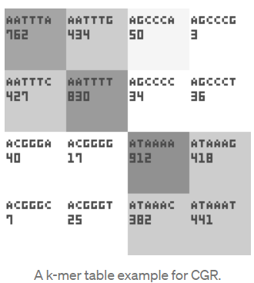
How CGR images are generated?
The program creates an image showing the abundance of all k-mers in a given sequence.
For a k-mer of length k, the image will be consisting of 4^{k} boxes, each box representing an oligomer.
The oligomer name and abundance is written within these boxes, and abundance will also be visualized with the box colour , from white(none) to black(highly frequent).
The k-mer table is alternatively known as the FCGR(frequency matrices extracted from Chaos Game Representation)

Slide 11
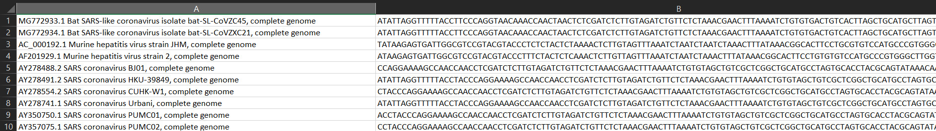
DATASETS
Considered five datasets:
Coronaviridae
Alphacoronavirus
Microviridae
Bromoviridae
Geminiviridae
The first column of each row represents the species ID and description.
The second column of each row represents the sequence of the data.

Slide 12
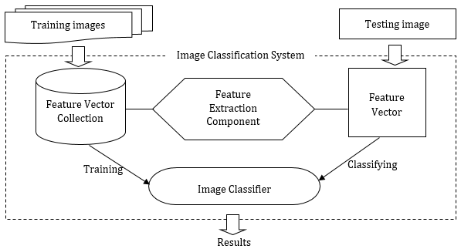
Can CGR Images be used as Features to effectively differentiate Sequences??

Slide 13
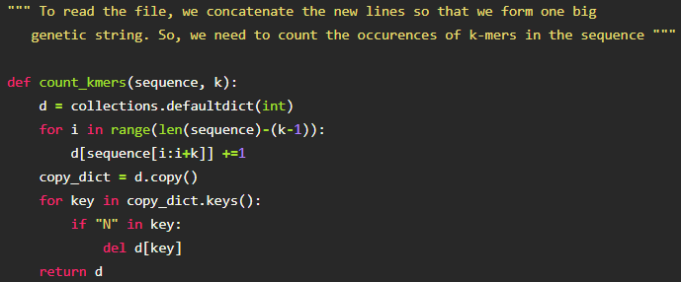
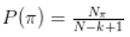
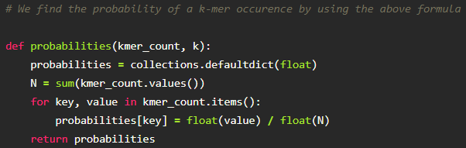
K-mer Count
K-mer Probabilities
Here, N is the length of the sequence, k is the length of the k-mer and N(pi) is the occurences of the k-mer

Slide 14
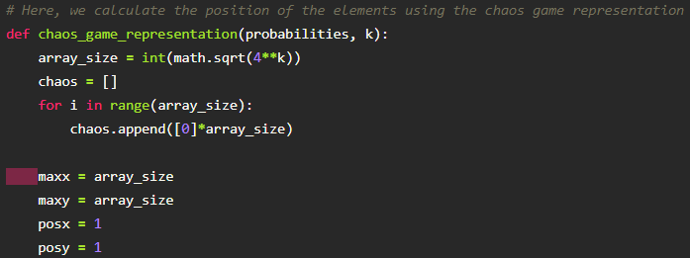
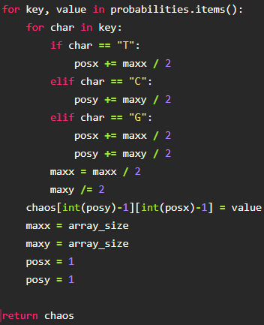
Generating CGR Array

Slide 15
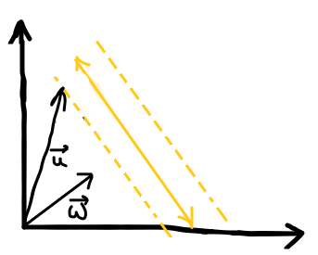
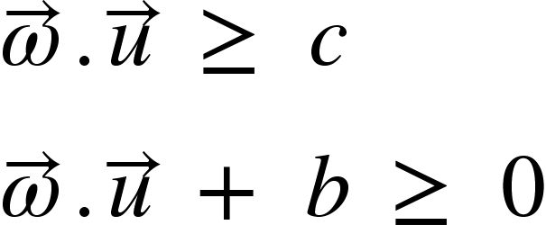
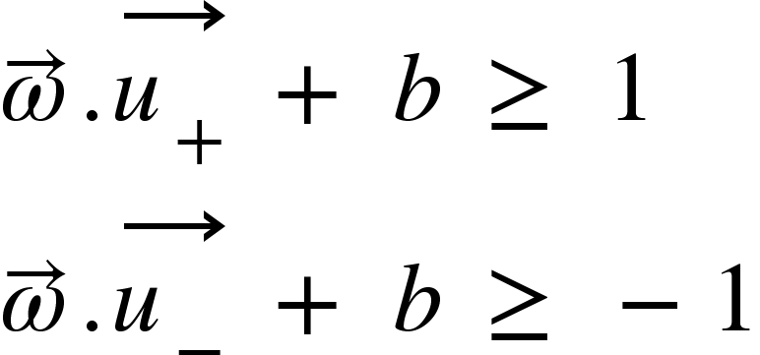
Support Vector Machines

Slide 16
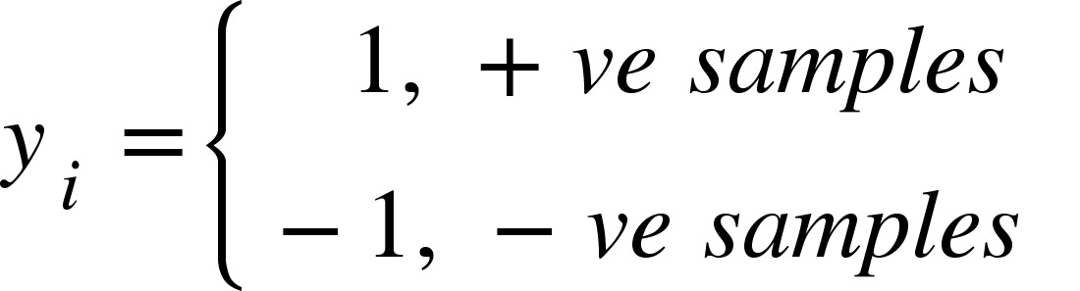
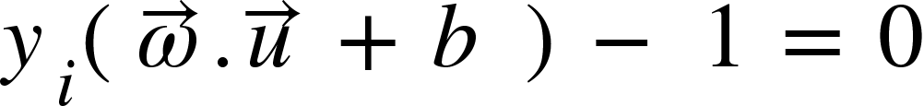
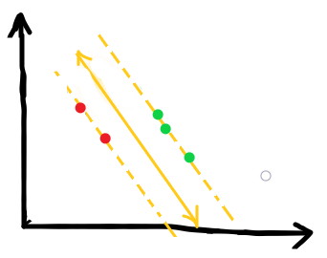
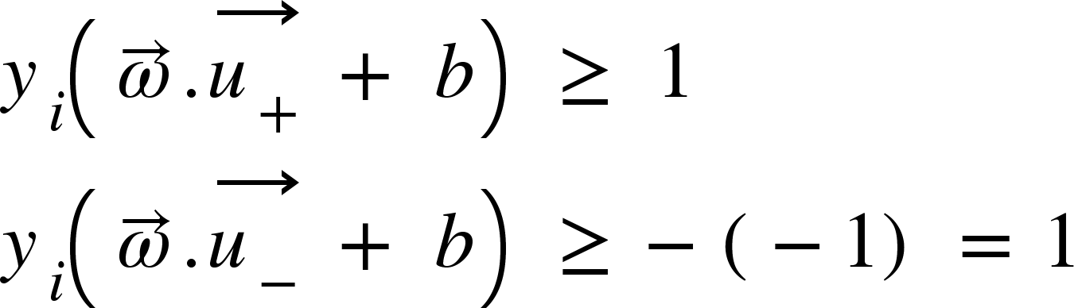
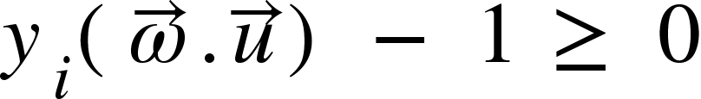

Slide 17
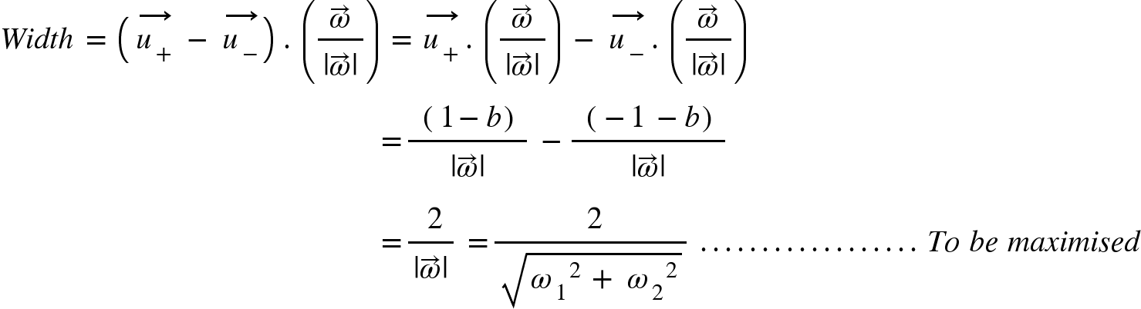


Slide 18
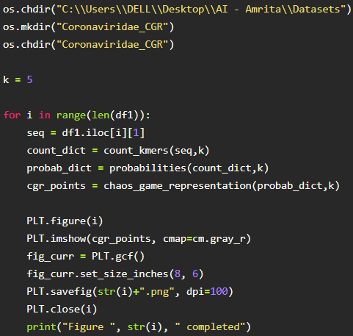
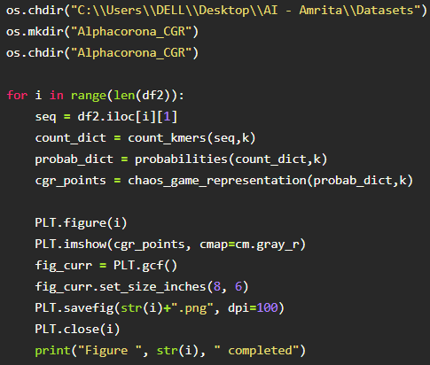
Generating and storing CGR Images

Slide 19
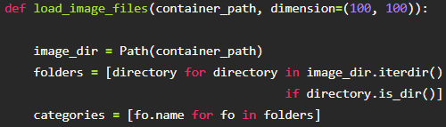
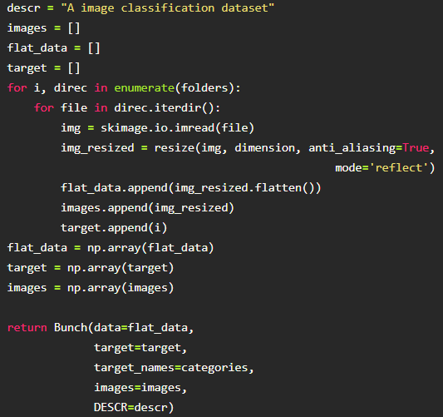
Loading the 2 classes of Images

Slide 20
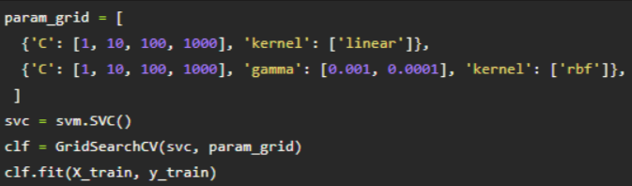
Understanding the GridSearchCV
GridSearchCV implements a “fit” and a “score” method.
It is a process of performing hyperparameter tuning in order to determine the optimal values for a given model. We pass predefined values for hyperparameters to the GridSearchCV function.
We do this by defining a dictionary in which we mention a particular hyperparameter along with the values it can take.
GridSearchCV tries all the combinations of the values passed in the dictionary and evaluates the model for each combination using cross-validation method.
Here, C, gamma and kernels are some of the hyperparameters of an SVM model.

Slide 21
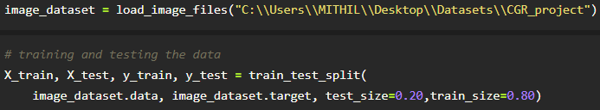
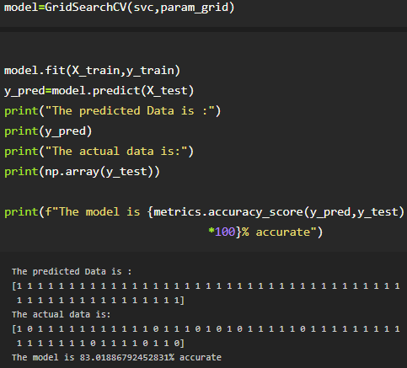
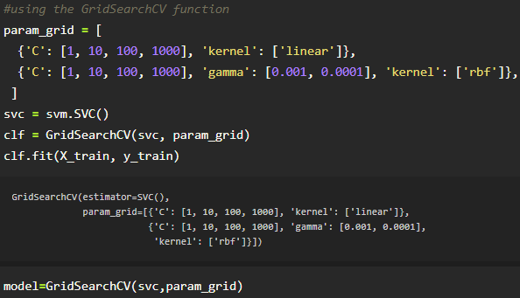
Test-train split, Prediction

Slide 22
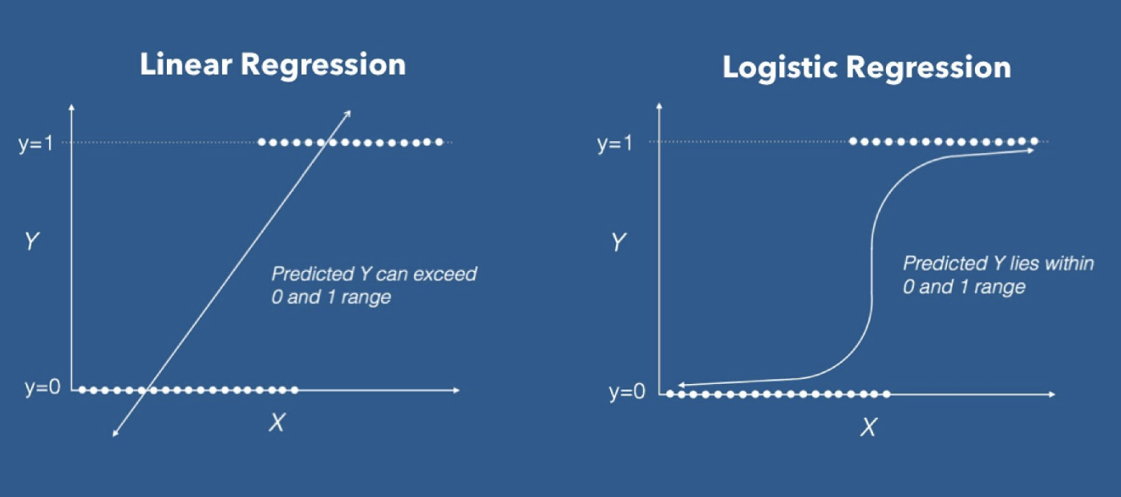
Logistic Regression
Used for Binary or Multiclass classification
LR can work with both continuous & discrete data
Instead of a straight line, a logistic function is fitted through the data points
Instead of Least squares, the maximum likelihood is the deciding factor

Slide 23
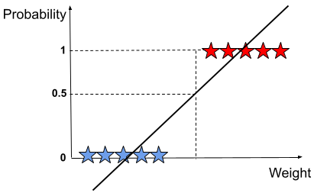
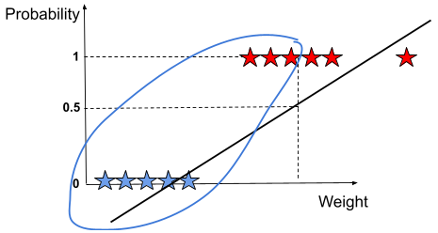
Fallbacks of Least square error
Outliers may result in poor model performance when the least squared error is considered

Slide 24
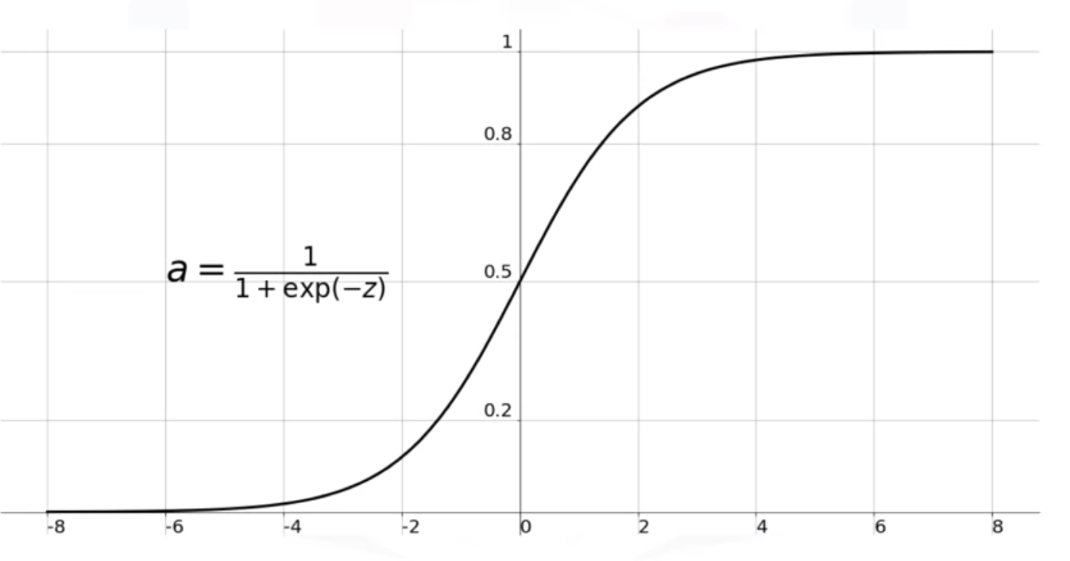
Sigmoid Activation Function
When a sigmoid function is used, the error values fall in the range 0-1. So, outliers do not affect the fitted curve very much.

Slide 25
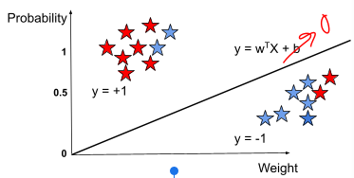
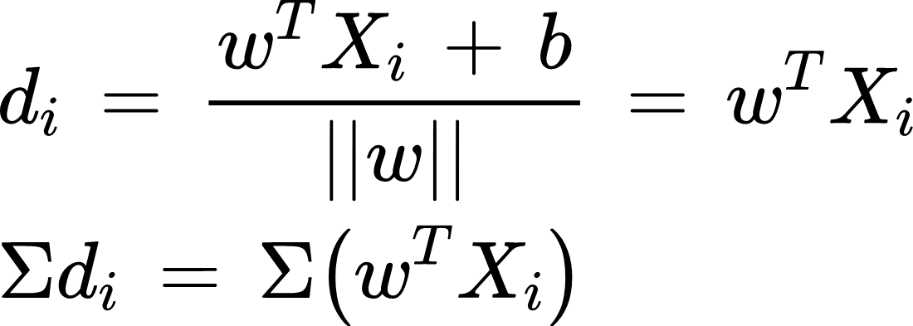
Geometric Meaning
Distance of any point from the line :
When a sigmoid function is used, the error values fall in the range 0-1. So, outliers do not affect the fitted curve very much.

Slide 26
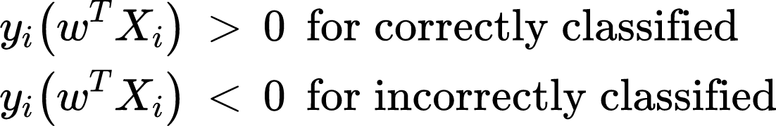
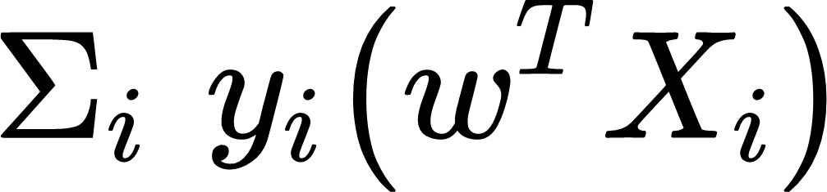
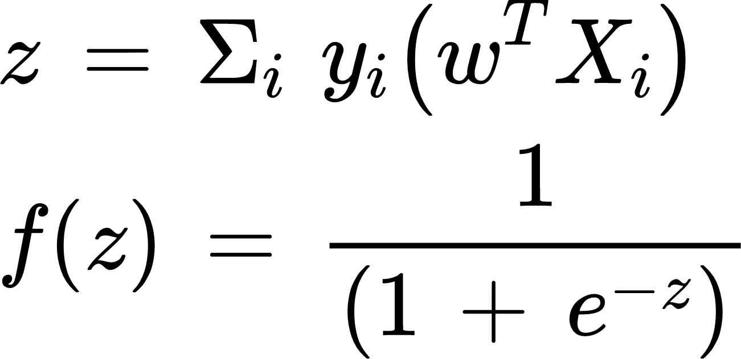
So, the following has to be maximised:
Alternatively, the following Sigmoid function can be maximised:

Slide 27
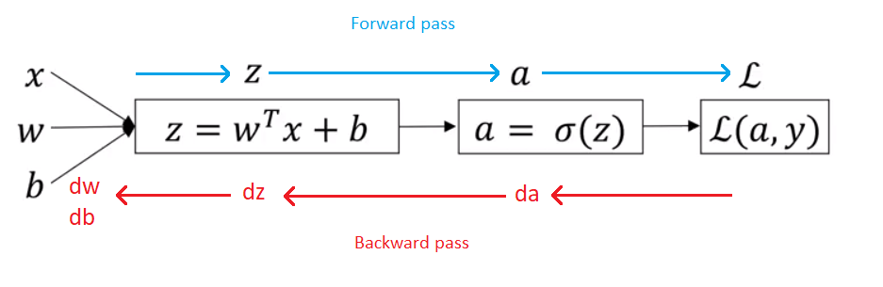
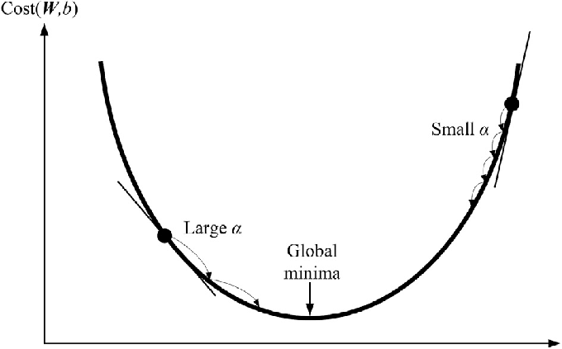
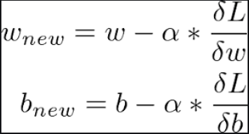
Propagation
Update Equation
Forward propagation : Computing value of the activation function
Backward propagation : Updating the weights to give a lesser cost value

Slide 28
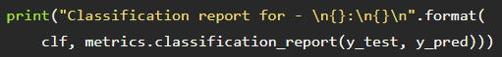
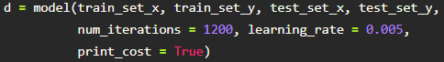
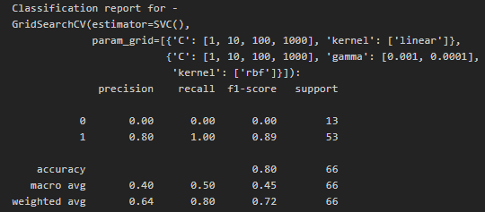



OBSERVATIONS
SVM Model
Logistic Regression Model

Slide 29



Geminiviridae-Coronaviridae
Microviridae-Coronaviridae
Bromoviridae-Microviridae

Slide 30
Conclusion & Future-work
CGR provides us a more simple way for viewing, sorting, and comparing various gene structures, even for longer DNA sequences.
This is a basic implementation of the C.G.R, this hasn’t been optimized for speed or better depiction for higher k-values. The vectorial depiction can be utilized at higher dimensions with better features which can improve numerous ML model classifications and pattern matching of genetic sequences.
A three-dimensional visualization of genomic sequences can be made possible. In this method, instead of four points as four bases in nucleotide sequences, eight points are considered as eight corners of a cube. Four different nucleotides in protein coding regions of sequence (A,T,C,G) and four different nucleotides in non-coding regions of sequence(A,T,C,G) can be used to map equations of chaos game in a three dimensional space which is then used to convert a genomic sequence to a three-dimensional space. This obtained visualization can be used for analysis of whole genomes based on coding and non-coding regions.

Slide 31
THANK YOU!!

